Slide 1
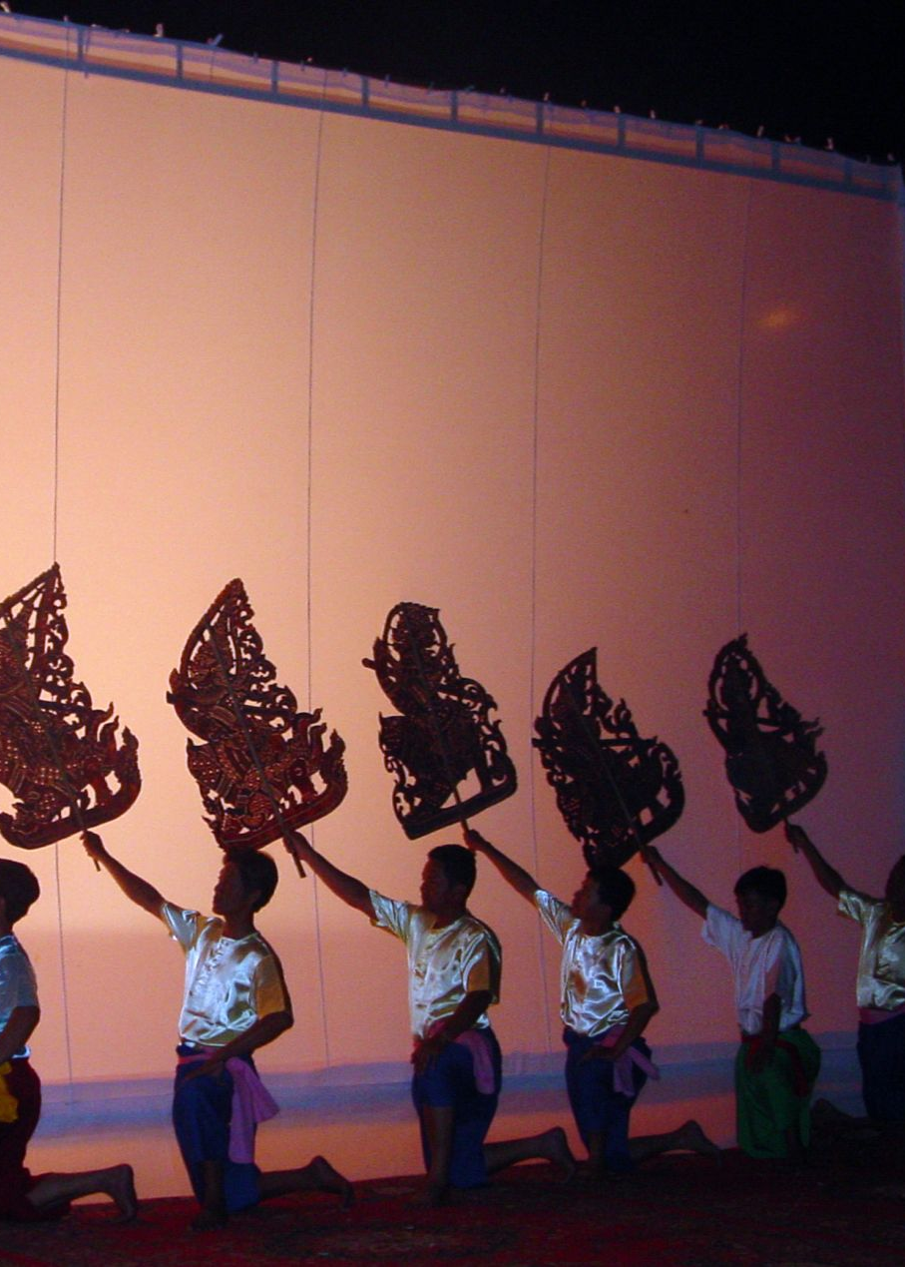
Integrating Disaster Risk Reduction into ICH Inventorying
U064 PowerPoint presentation
UNESCO
Intangible Cultural Heritage Section

Slide 2
In this presentation …
Goal: Learn how to apply a community-based approach to the inventorying and safeguarding of intangible cultural heritage in the context of disasters.
  Building on the knowledge acquired in Unit 63, this unit provides frameworks, tools and exercises to integrate disaster awareness into the inventorying and safeguarding of ICH.
Coverage:
Brief recap of previous Workshop (Unit 063)
Identifying ICH in Disasters – case study of ICH and disaster, and a framework for analysis
Exercises – integrating disaster awareness in community-based inventorying, and inventorying ICH for Disaster Risk Reduction
Preparation for Group Exercise
Cultural permissions and FPIC
Notes:
Permissions and FPIC
Choice in these workshops to work with real ICH elements and real disasters – because they generate real questions and real challenges
AS explained in last week’s workshop, community is the basis for our understanding of ICH and for thinking about appropriate disaster responses.
So it is important that we have some kind of community permission, based on real Free, Prior and Informed Consent, in further discussion of the ICH elements that we identified and began to talk about at the end of last week’s workshop.
We’ll continue to explore these elements today – or rather think about how we would go about further enquiries – but I do also want to stress that our discussion of these or any other ICH in these workshops is not intended as the basis of any formal process of documentation, or listing, or inscription.
Really, what we’re doing is talking and thinking about methods for integrating approaches to disaster risk and ICH safeguarding, and we are not focusing on the ICH elements themselves.
But it will be appropriate and necessary for the research groups that work together over the next few weeks to consider what level of FPIC and permissions might be required even to discuss individual ICH elements in this way.

Slide 3
Key Lessons of the Operational Principles and Modalities
ICH, in a disaster context:
  has a dual nature (vulnerability and risk reduction)
  requires an assessment of vulnerability, and emergency safeguarding measures, plans and funding
  can be deployed in all phases to mitigate the impacts of disaster
Actors, who need to be involved and in communication with each other, must include:
  communities (central to the identification and safeguarding of ICH)
  states parties and national agencies
  disaster relief and risk reduction managers
Planning and assessment, in all phases, must involve:
  input from and adequate resourcing of all actors, especially communities
  consideration, integration and incorporation of ICH safeguarding and mitigation at all levels from local to national (including PDNAs)
  sharing of information and results across all levels

Slide 4
Identifying ICH in Disasters: “People, Place, Story” – a framework for analysis
“People, Place, Story” is a model that helps us to understand the connections between a living community, its physical environment, and its local knowledge.
Distinguishing between the human, tangible and intangible aspects of all ICH allows us to better understand how ICH is transmitted, where it is vulnerable, and thus the challenges and requirements of safeguarding.
  People are the human agents of ICH (individuals, communities, bearers, ancestors)
  Place is the tangible, material world (landscapes, buildings, artefacts, resources)
  Story represents the immaterial or the intangible (knowledge, narrative, tradition, language).

Slide 5
Identifying ICH in Disasters: Articulation, Transmission and Safeguarding
The three different Modalities (People, Place, and Story) come together in the Articulation of actual, dynamic acts of performance, practice or production of ICH.
Transmission is the communication of that ICH (as knowledge and practice) across both space and time.
Safeguarding refers to the full suite of strategies (from local through to international) that understand and aim to support and enhance the viability of each of the different components of the “People, Place and Story” framework.

Slide 6
Identifying ICH in Disasters: the People, Place, Story Framework

Slide 7
Identifying ICH in Disasters: Introducing the Case Studies
Through two Case Studies, we will explore and identify examples of:
a) the impact of disasters on ICH, and
b) the role of ICH in reducing or mitigating risk in disaster contexts.
The Case Studies include:
  Case Study 1: Cyclones and ICH in Northern Vanuatu
  Case Study 2: Mount Merapi, Indonesia: living on a volcano

Slide 8
Exercise 1: Impact of disaster on ICH
Learning objective:
Apply a preliminary disaster risk analysis to the ICH element that your group selected in the previous Unit / Workshop
Method:
Use the “People, Place and Story” framework to think about different kinds of ICH vulnerability, and exposure to different kinds of disaster
How has the viability of your ICH element been impacted over a long period by one or more disasters or other emergencies?
Record your example on Handout 2.

Slide 9
Handout 2: ICH Impacted by Disaster
Exercise 1 – ICH Impacted by Disaster
Name of element | What kinds of disaster or emergency have impacted on this ICH element over time? | Which aspects of the element have been threatened or impacted? People? Place / Tangible resources? Story / Intangible resources? Practice? Transmission?

Slide 10
Exercise 2: Group Research on ICH Disaster Risk – goal and objectives
Goal:
To complete the ICH Disaster Risk assessment for a selected ICH element
This can be started during the workshop, or tackled later
Learning objective:
This exercise enables participants to consider:
the impact of one or more hazards and emergencies on the safeguarding or ongoing practice of one or more ICH elements
how the ICH might be mobilised during and after the hazard to mitigate the impact of disaster
how the ICH might be transformed by the disaster or adapted by its bearers
what measures need to be put in place to safeguard ICH and strengthen its transmission following disaster

Slide 11
Exercise 2: Group Research on ICH Disaster Risk – steps
Steps:
Each group uses the same ICH element considered in last week’s workshop and today’s Exercise 1 - or chooses a new one (or several!)
Confirm cultural permission or FPIC requirements associated with the selected ICH element(s)
Each group meets to complete the remaining steps, doing further research as necessary
Complete any gaps in Handout 1 from Unit 063, and in Handout 2 from this module
Respond to the questions and prompts in Handout 3
Present the full results for discussion

Slide 12
EXERCISE 2a:
ICH Risk in each phase of the Disaster Management Cycle
This exercise allows your group to further develop Section 3 of the Sample Inventorying Framework “State of the ICH element: viability” (Handout 1 from Workshop 1)
Phase: | Response | Recovery | Preparedness
Threats to continued enactment
Threats to continued transmission
Threats to access to resources
Viability of other ICH
Safeguarding or other measures in place
Safeguarding or other measures required

Slide 13
Exercise 2b: Role of ICH in Mitigating or Reducing Disaster Risk
Record any examples of a role for your ICH element (or any other related ICH) in any of the three phases of the disaster cycle:
ICH that is used to prepare for disaster
ICH that is used in the response phase of a disaster
ICH that is used to recover from disaster
Name of element | Preparedness | Response | Recovery

Slide 14
A self-test
Test yourself – now or later!
What is the distinction between a natural hazard and a disaster?
What are some of the reasons why impacts to ICH have been difficult to capture in Post Disaster Needs Assessments?
What is the difference in emphasis between DRM and DRR?
What are the different phases of the disaster cycle, and why are they different?
How do the Operational Principles inform practical measures in each phase of the disaster cycle?
Is there emergency financial or technical support available to support ICH safeguarding?
How are the different modalities of ICH transmission and safeguarding brought together and articulated?
Can you think of any critical issues for ICH inventorying and safeguarding in the context of disasters that have not been addressed in Units 63 and 64?

Slide 15
